Slide 1
Fit with AI Bunny App
Sreeja Reddy Kota

Slide 2
Project overview
The product:
The fitness app offers personalized workout recommendations through AI-driven insights and an intuitive interface. It caters to fitness enthusiasts, beginners, and individuals seeking structured, goal-oriented workout plans.
Project duration:
Project Duration: May 2024 – August 2024
Documentation Period: January 2, 2025 – February 11, 2025

Slide 3
Project overview
The problem:
Users struggle to find personalized and effective workout plans that align with their fitness goals and progress. Existing fitness apps often lack intuitive navigation and AI-driven guidance, making it difficult for users to stay engaged and consistent in their fitness journey.
The goal:
The goal of the project was to design an intuitive and engaging fitness app that offers personalized workout recommendations through AI-driven interactions. The focus was on enhancing user experience by ensuring seamless navigation, accessibility, and a structured workout discovery process.

Slide 4
Project overview
Sreeja Reddy Kota
My role : UX Researcher, User Experience (UX) Designer, UI/Interaction Designer
Responsibilities:
User Research, Information Architecture, Market Research, Wireframing, Prototyping, User Testing, UI Design, Collaboration

Slide 5
User research
Empathy map
Personas
Pain Points
User journey maps
Solutioning
Understanding
the user

Slide 6
User research: summary
The user research primarily focused on urban working professionals across various occupations, including business professionals, healthcare workers, educators, and IT professionals. We assumed that most professionals struggle to maintain a healthy work-life balance, manage stress, and prioritize fitness due to time constraints and sedentary lifestyles. To validate these assumptions, we analyzed user demographics, fitness goals, and activity levels while exploring their unique challenges, such as irregular schedules and physical exhaustion.
After conducting the research, we discovered nuanced trends: stress management and customization of fitness routines were universally valued, while specific user groups expressed unique needs, such as recovery-focused exercises for manual labor workers and creative, flexible solutions for artists and designers. These insights shifted our understanding from general assumptions to a more targeted and inclusive perspective, emphasizing the importance of personalization and technology integration in fitness solutions.

Slide 7
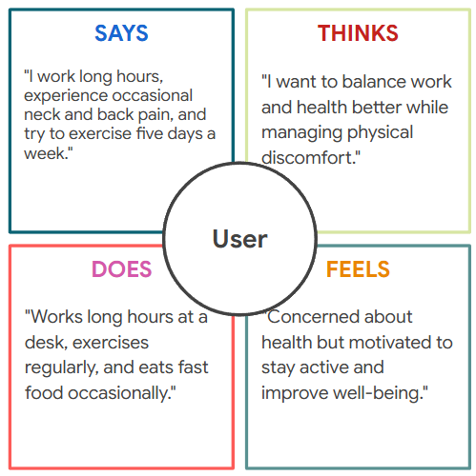
Empathy Map: Interview Summary
For our user research, we conducted semi-structured interviews with working professionals to understand their lifestyle challenges and health concerns. Initially, we assumed that most users would prioritize fitness and be open to app-based solutions to address physical inactivity, work stress, and sleep issues. However, the research revealed nuanced perspectives: while some participants valued convenience and guidance through technology, others preferred self-management over app dependency. These insights highlighted the need for a flexible, holistic approach to cater to diverse preferences, emphasizing mental well-being, ergonomic solutions, and time-efficient physical activities.

Slide 8
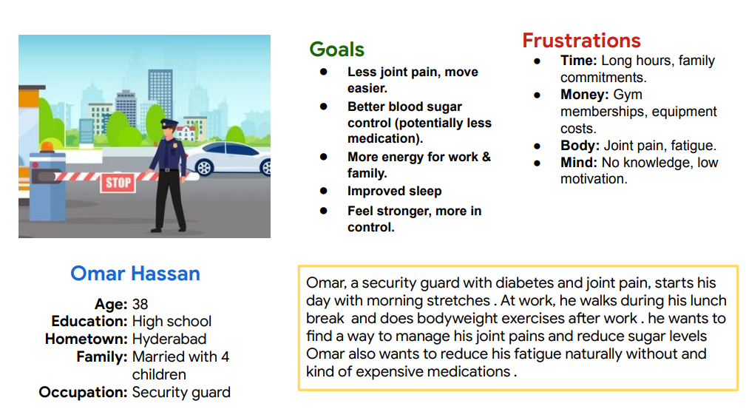
Persona: Omar
Problem statement:
Omar is a security guard with diabetes and joint pain
who needs a simple, affordable fitness routine to reduce joint pain and manage blood sugar
because his long work hours, family commitments, and limited resources make it difficult to prioritize his health.

Slide 9
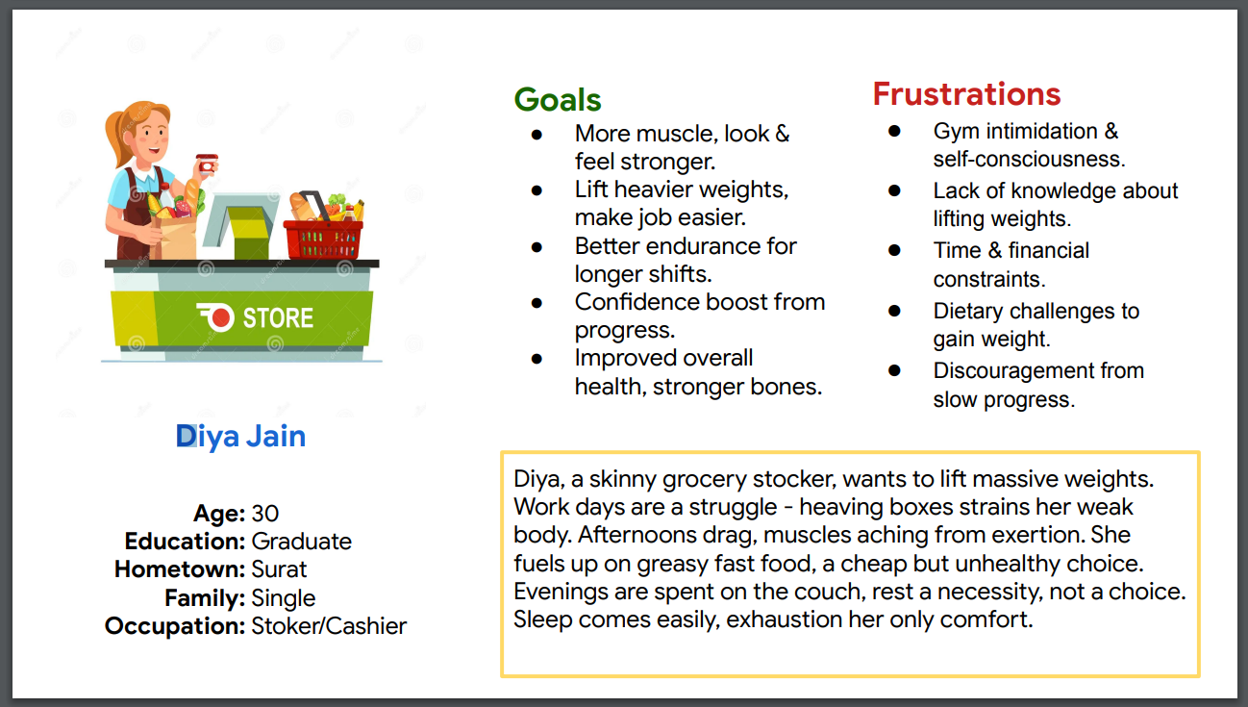
Persona: Diya
Problem statement:
Diya is a hardworking cashier and stocker with a physically demanding job
who needs an affordable fitness plan to build muscle, improve endurance, and boost confidence
because her job strains her body, and limited resources make it hard to pursue structured fitness or a healthy diet.

Slide 10
User research: pain points
1
2
3
4
Pain point
Pain point
Pain point
Pain point
The growing trend of technology integration highlights the value of including features like wearable syncing, progress tracking, and interactive reminders for holistic health management.
The challenge of time constraints emphasizes the importance of designing quick, efficient workouts that fit into busy schedules without compromising effectiveness.
The need for stress management across all groups suggests incorporating mindfulness practices, relaxation techniques, and community features into the design.
The desire for personalization underscores the necessity of creating adaptive fitness plans that align with individual goals, preferences, and activity levels.

Slide 11
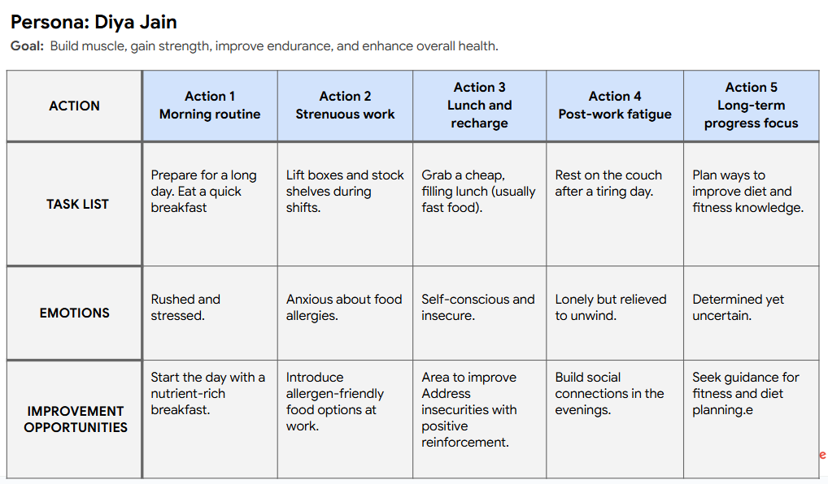
User journey map
The user seeks to improve their daily routine by starting with a healthy breakfast, reducing physical strain at work, and making better dietary choices. They aim to establish a post-work fitness routine and stay motivated in their fitness journey by tracking progress, finding a gym mentor, and focusing on gradual improvements.

Slide 12
Paper wireframes
Digital wireframes
Low-fidelity prototype
Usability studies
Starting
the design

Slide 13
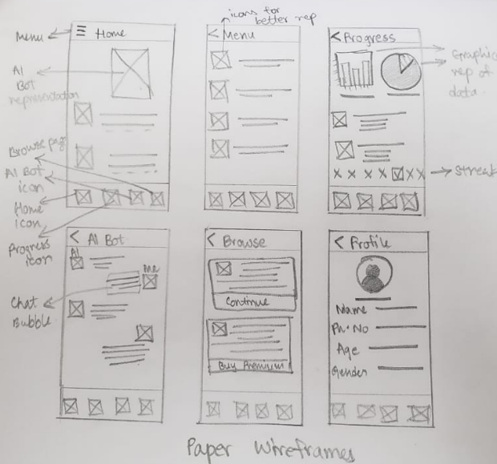
Paper wireframes
The paper wireframes are focused on defining the app’s core structure and user flow before digitization. The goal was to create an intuitive layout that prioritizes easy navigation, AI-driven personalization, and quick access to workouts. Sketching different variations helped refine element placement, ensuring a seamless user experience. Key features, like the AI avatar, categorized workouts, and navigation bar, were strategically positioned for accessibility. This early-stage design allowed for rapid iterations, aligning with user needs before high-fidelity development.

Slide 14
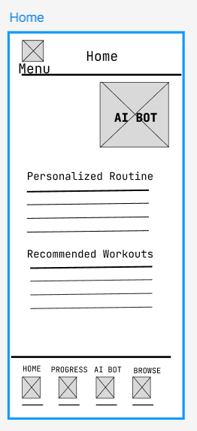
Digital wireframes
The menu provides quick access to essential features, allowing users to navigate seamlessly.
The low-fidelity wireframes focus on simplicity, user flow, and core functionality. The goal is to create an intuitive fitness app that personalizes workout plans based on user preferences and progress. The AI avatar enhances engagement by guiding users to tailored routines and AI-driven chats. A structured navigation bar ensures seamless access to key features like progress tracking and browsing workouts. Categorized workout recommendations improve usability, making it easier for users to find suitable exercises quickly.
The AI avatar tailors workouts based on user progress and directs them to the "Chat with AI Bunny" page for guidance.
Helps users quickly find the type of workout they need, improving accessibility and usability.

Slide 15
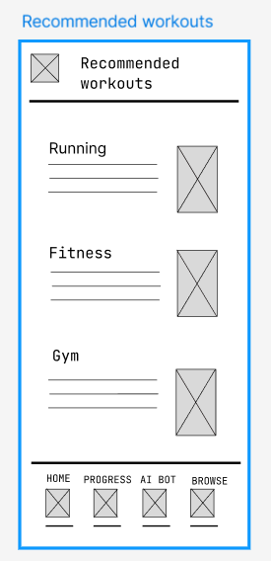
Digital wireframes
The Recommended Workouts screen is designed for easy discoverability and quick access to exercises. Categorized sections like Running, Fitness, and Gym help users navigate efficiently. Thumbnail images provide visual cues, making selection intuitive. Brief descriptions summarize each workout purpose, ensuring informed choices. A fixed navigation bar enhances accessibility, allowing seamless transitions between key app features. The goal is to create a structured yet engaging experience that simplifies workout selection while maintaining a user-friendly interface.
Organizes exercises into sections like Running, Fitness, and Gym for easy navigation.
Briefly outlines each workout purpose and benefits for informed decision-making.
Ensures seamless access to home, progress tracking, AI interactions, and workout browsing.

Slide 16
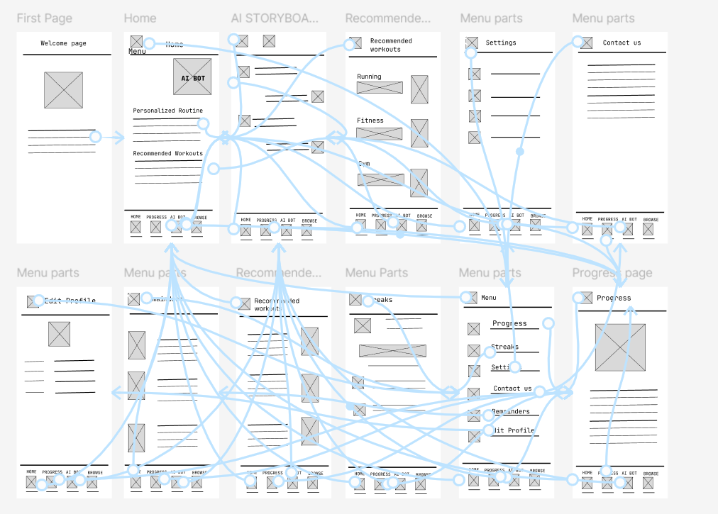
Low-fidelity prototype
Link to low-fidelity prototype - https://www.figma.com/proto/LM7L8au3vCDDTcHGeaxQrr/Fitness-app-Low-Fidelity-Prototype?node-id=2002-3703&p=f&t=ga5dSUmo4vqS6FAM-0&scaling=scale-down&content-scaling=fixed&page-id=0%3A1
Link to figma pages -
https://www.figma.com/design/LM7L8au3vCDDTcHGeaxQrr/Fitness-app-Low-Fidelity-Prototype?t=U8LK4vWd2C0Ffj3u-1

Slide 17
Usability study: findings
We conducted two usability studies to assess our fitness app’s user experience. The first round identified navigation challenges, UI clarity issues, and AI interaction difficulties. After refining the design, the second round evaluated improvements in navigation, AI engagement, and readability, leading to a more intuitive and accessible app.
Round 1 findings
Round 2 findings with High-Fidelity Prototype
1
Lack of Visual Hierarchy
1
Improved Navigation but Needs Optimization
2
Navigation Complexity
2
Better Engagement with AI Coach
3
Unclear AI Interaction
3
Enhanced Readability and UI Design

Slide 18
Refining
the design
Mockups
High-fidelity prototype
Accessibility

Slide 19
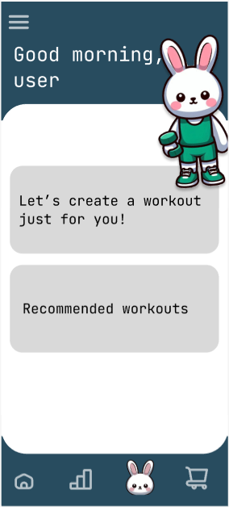
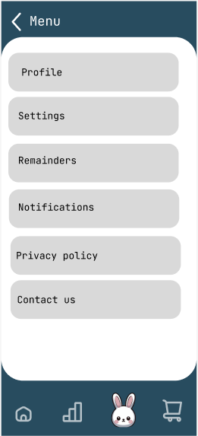
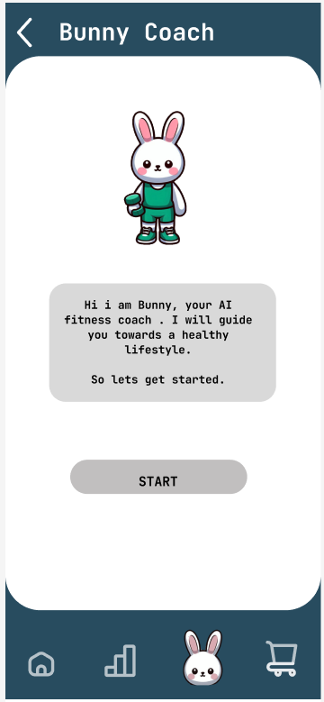
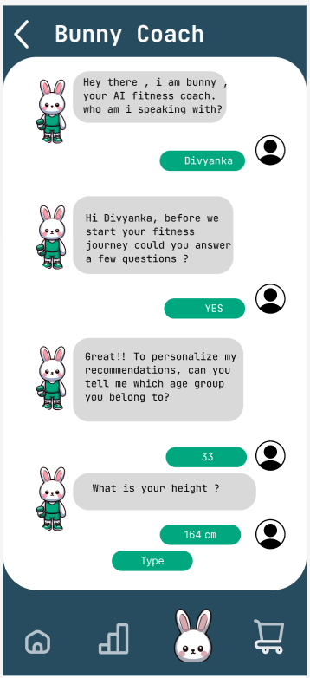
Mockups
Main mockup screen for display
Main mockup screen for display

Slide 20
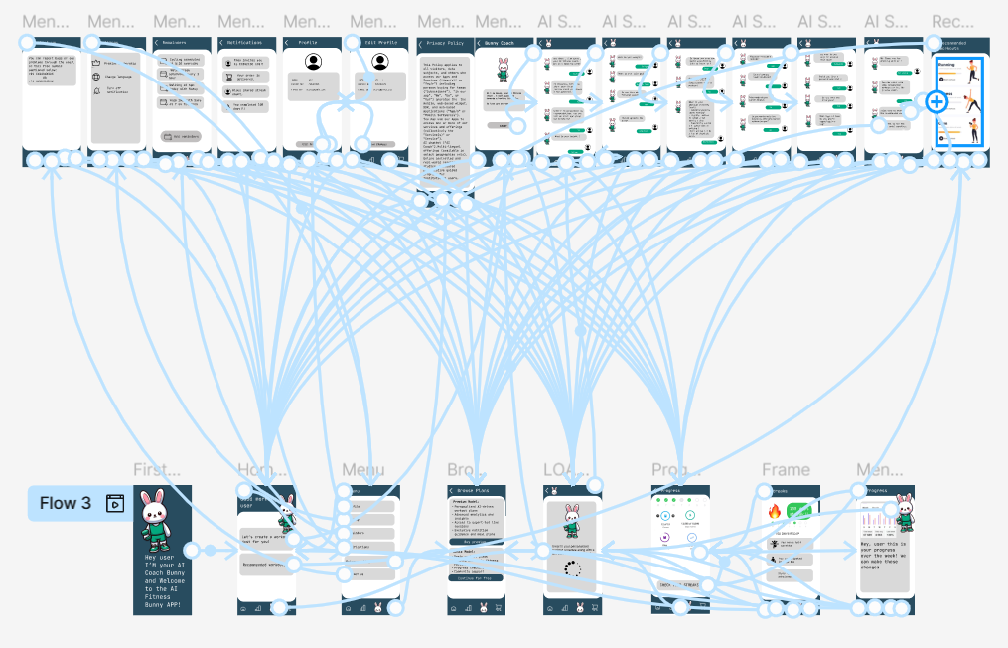
High-fidelity prototype
Link to high-fidelity prototype -
https://www.figma.com/proto/Rb8HPgS8HTjRZx0wSPFXm7/Fitness-App-High-Fidelity-Prototype?t=U8LK4vWd2C0Ffj3u-0&scaling=scale-down&content-scaling=fixed&page-id=0%3A1&node-id=0-1&starting-point-node-id=2%3A412
Link to Figma Pages-
https://www.figma.com/design/Rb8HPgS8HTjRZx0wSPFXm7/Fitness-App-High-Fidelity-Prototype?t=U8LK4vWd2C0Ffj3u-1

Slide 21
Accessibility considerations
1
2
3
Color Contrast & Readability:
The design follows WCAG guidelines by using high-contrast colors and legible typography to ensure readability for users with visual impairments. Important text elements and buttons stand out clearly against the background.
Clear Navigation & Icons: The app uses intuitive icons and a structured menu layout to assist users in quickly identifying and accessing key features. This helps users with cognitive disabilities and first-time users navigate without confusion.
Voice and Text Support for AI Coach: The AI Bunny provides both text-based and potential voice command options to accommodate users with different interaction preferences, making the app accessible for individuals with motor or visual impairments.

Slide 22
Understanding
the Market
Market Research
Applicable Business Plan
Versions/Models

Slide 23
Market research: summary
The Indian fitness industry is rapidly expanding, valued between $6.5 billion and $12 billion in 2018, with a projected market size of $19.24 billion by 2027 and a CAGR of 8.6%–11.57%. Growth is driven by rising disposable income, increasing health awareness, and fitness technology adoption. AI-powered hyper-personalization in fitness apps enhances user engagement through customized workout plans, real-time adjustments, virtual coaching, and nutritional guidance.
For a successful fitness app, UI/UX design is crucial. Key features include intuitive navigation, personalized dashboards, seamless integration with wearables, and engaging visuals. AI-driven recommendations, gamification, and interactive elements can improve motivation and user retention. With busy professionals increasingly relying on fitness apps, accessibility and usability are essential. By integrating AI for real-time feedback, offering adaptive workout plans, and ensuring a smooth, engaging experience, the fitness app can stand out in the growing Indian market while helping users achieve their health goals effectively.

Slide 24
Applicable Business Plans
The following business models can be applicable for a fitness application:
Subscription-Based Model – Users pay a recurring fee (monthly/yearly) for access to premium features such as personal coaching, doctor consultations, and professional guidance.
Freemium Model – Basic features are free, but premium features (like personalized coaching) require payment.
Pay-Per-Service Model – Users pay only for specific services like individual doctor consultations or one-time coaching sessions.
Marketplace Model – The app connects users with professional coaches and doctors, earning commission on transactions.
Affiliate/Partnership Model – Partnering with health brands for referrals and promotions within the app.

Slide 25
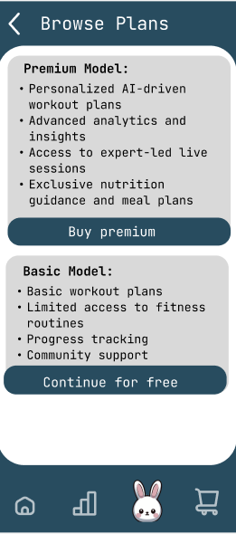
Versions/ Models:
The freemium model is a popular monetization strategy where the basic version of an app is free, while premium features require a paid subscription or one-time purchase. This model allows users to experience the app's core functionalities without upfront costs, increasing user acquisition and engagement.How the Freemium Model Works in Fitness Apps
Free Features:
Premium Features (Paid Subscription or One-Time Purchase)
Why It Works?
-Low Barrier to Entry: Users can explore the app risk-free, increasing adoption rates.
-User Engagement & Habit Formation: Free access encourages consistent usage, making users more likely to upgrade for advanced features.
-Monetization Flexibility: Revenue comes from subscriptions, in-app purchases, and ads.
-Scalability: A large user base improves AI personalization and community engagement.
-Data-Driven Optimization: Free users generate valuable insights for improving premium offerings.

Slide 26
Going forward
Takeaways
Next steps

Slide 27
Takeaways
Impact:
The redesigned app provided a more seamless and personalized fitness experience, making it easier for users to navigate and stay engaged. One participant shared, "The app design feels much more intuitive now, and the AI Bunny makes workouts fun and motivating!"
What I learned:
In this project, I focused on user-centered design, refining navigation, accessibility, and engagement through feedback and testing. I gained insights into the challenges faced by different professional groups and improved the digital experience by enhancing visual hierarchy and interactivity.

Slide 28
Next steps
1
2
3
I would work on optimizing the app's performance and integrating more personalized features to enhance user engagement. This would ensure a more seamless, user-friendly experience that evolves with user needs.
The next steps would involve conducting further user testing to gather more feedback and identify any remaining pain points. Based on this, I would refine the design to ensure it meets the needs of all users.
I will focus on expanding the app’s accessibility features, such as voice navigation or customizable text sizes, to ensure it is inclusive for users with different needs. This would help improve the app's usability for a wider range of people and align with inclusive design principles.

Slide 29
Insert a few sentences summarizing the next steps you would take with this project and why. Feel free to organize next steps in a bullet point list.
Let’s connect!
Feel free to reach out for any inquiries or to review more of my work. You can contact me via email at sreejareddyk812@gmail.com or visit my LinkedIn and GitHub profiles for further details.

